Slide 1


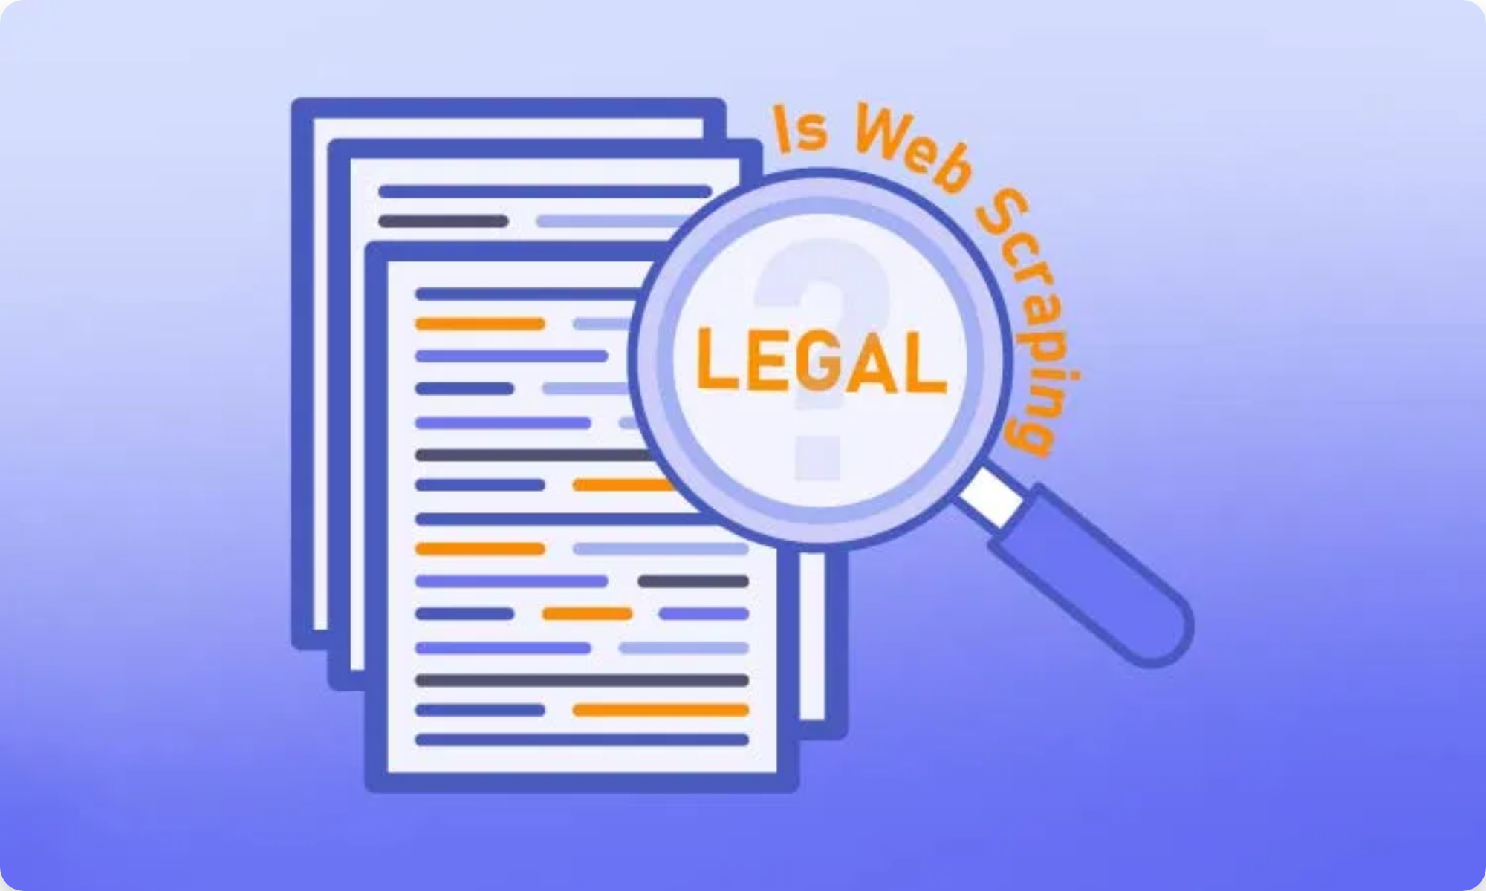
Introduction to Web Scraping
Definition:
Web scraping is the automated process of extracting data from
websites, also known as web harvesting or web data extraction
Common Uses:
Competitive intelligence (e.g., monitoring competitors' product prices)
Market research and analysis
Content aggregation
Academic research and data collection
Industry Growth:
The web scraping industry is expected to reach
$5 billion
by 2025
Legal & Ethical Concerns:
Despite its utility, web scraping raises significant
legal and ethical questions that vary by jurisdiction and context

Slide 2

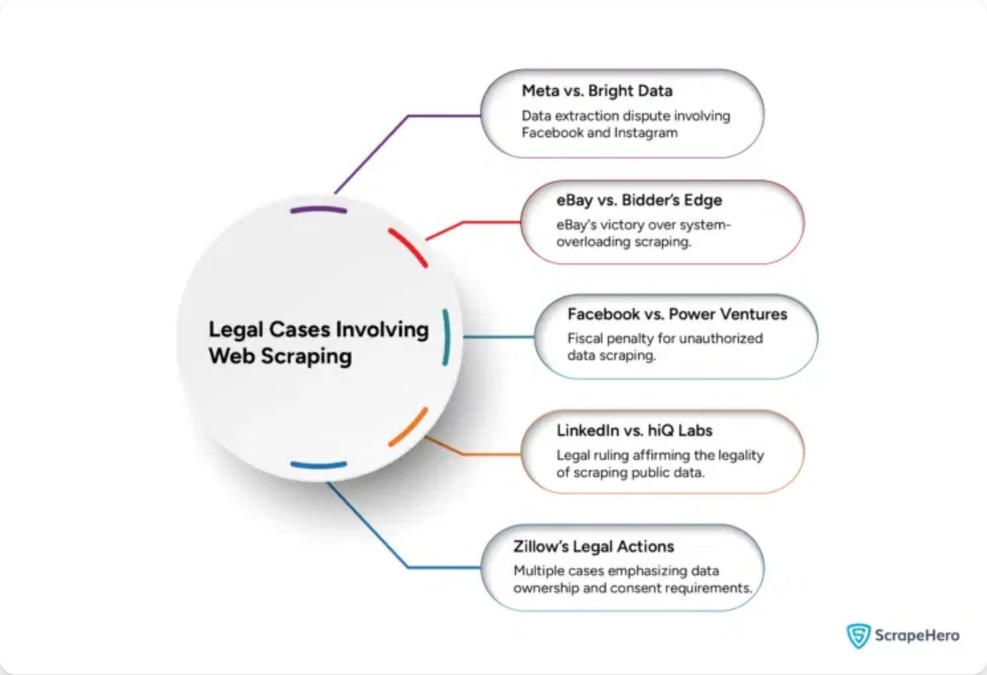



Legal Framework Overview
Key Laws Affecting Web Scraping:
Computer Fraud and Abuse Act (CFAA)
- U.S. law prohibiting
unauthorized access to computer systems
Copyright Law
- Protects original content on websites
Terms of Service (ToS)
- Contractual agreements that may prohibit
scraping
Privacy Laws
- GDPR (EU), CCPA (California), etc.
Jurisdictional Differences:
Legal approaches vary significantly between
the U.S., EU, and other regions
Legal Grey Area:
Web scraping is not inherently illegal, but legality
depends on methods used and whether it breaks website's terms of
service
Recent Trend:
Courts increasingly distinguish between scraping publicly
available data vs. password-protected content

Slide 3


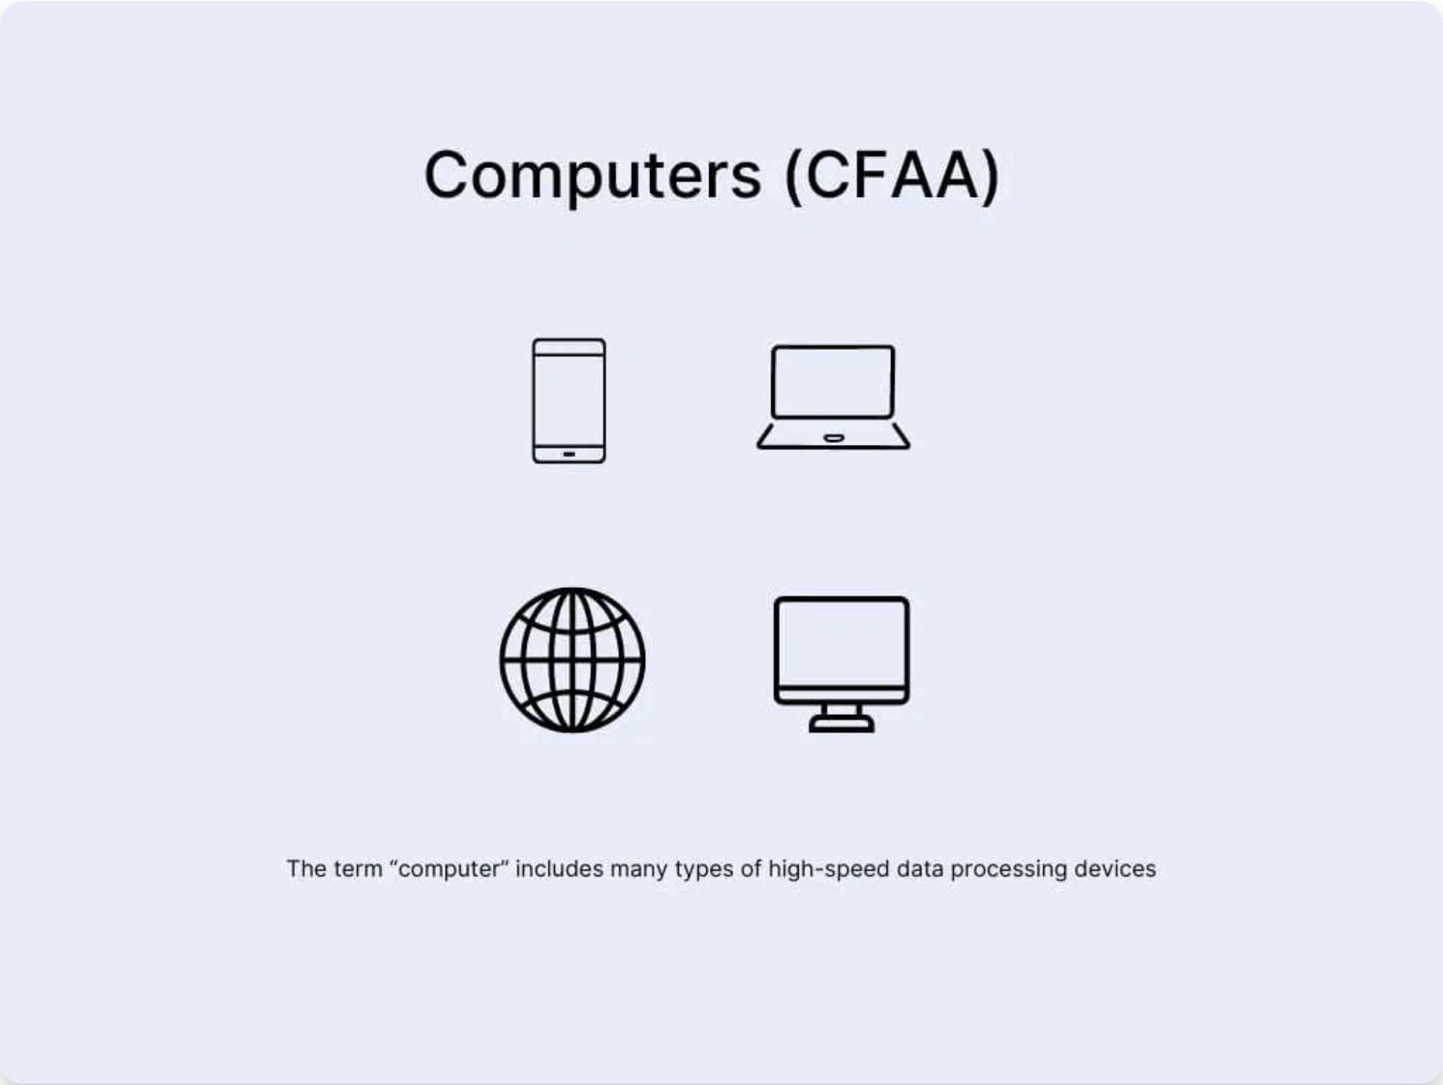

Computer Fraud and Abuse Act (CFAA)
Origin & Purpose:
Enacted in 1986 as an anti-hacking law that prohibits
accessing a computer "without authorization or exceeding authorized
access"
Originally focused on federal computers
Expanded to cover any computer used in interstate commerce
Now applies to most electronic devices
Key Issue for Web Scraping:
What constitutes "
unauthorized access
" or
"
exceeding authorized access
"?
Traditional Interpretation:
Violating a website's Terms of Service or
bypassing technical barriers (IP blocks) could violate the CFAA
Evolving Interpretation:
Recent court decisions have narrowed the CFAA's
scope, particularly for publicly available data

Slide 4


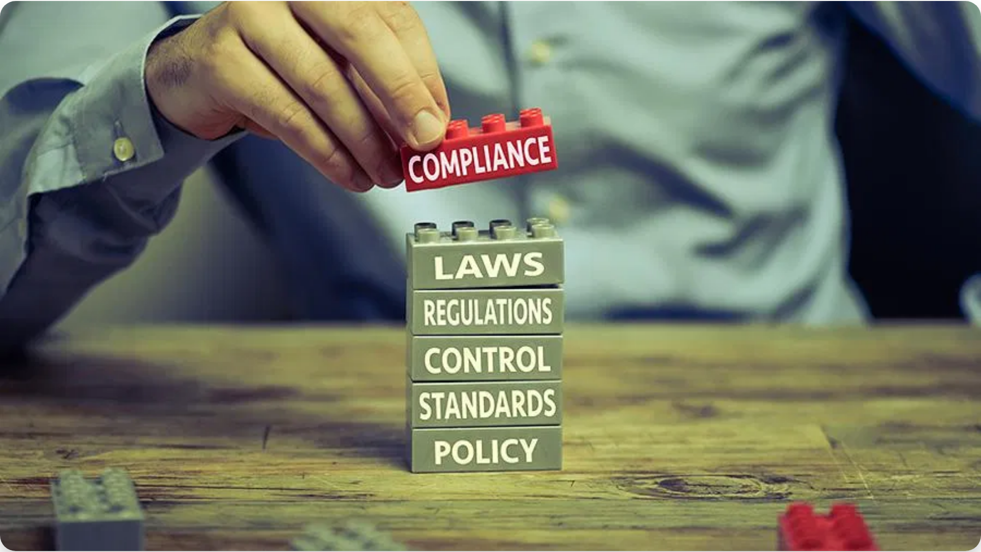

Ethical Considerations in Web Scraping
Respect for Website Owners:
Website owners invest significant resources
in developing and maintaining their platforms. Ethical scraping involves
obtaining permission and adhering to terms of service.
Data Privacy and Security:
Responsibly manage collected data, especially
personal or sensitive information. Comply with privacy regulations,
anonymize personal data, and implement strong security measures.
Transparency and Honesty:
Be transparent about scraping activities,
including purpose, methods, and data usage. Accurate information builds
trust and reduces ethical concerns.
Responsible Data Collection:
Only scrape necessary data, avoid server
overloading, respect robots.txt directives, and avoid deceptive practices
like IP rotation or user-agent spoofing.

Slide 5


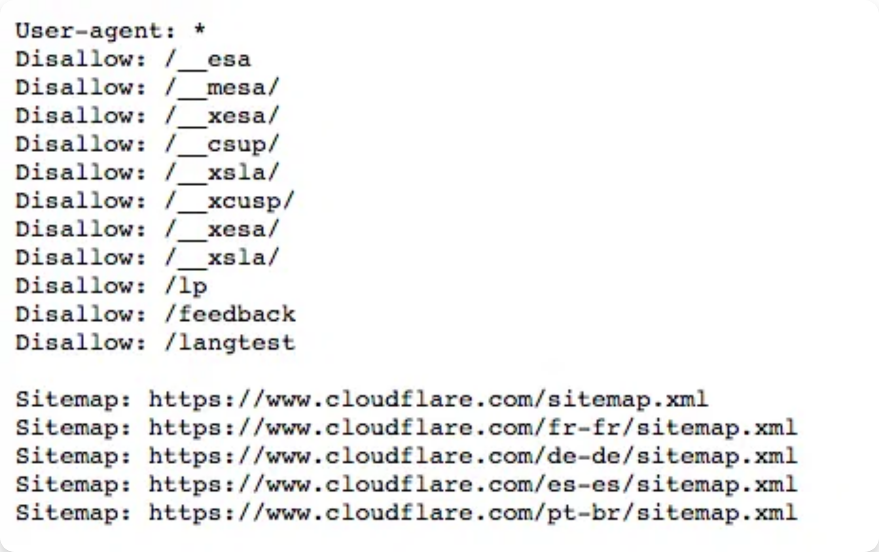


Best Practices for Legal Compliance
Respect Robots.txt Files:
• Honor directives that guide web crawlers on which parts of a site to avoid
• Check robots.txt before scraping any website
Implement Rate Limiting:
• Avoid overloading servers with excessive requests
• Space out requests with reasonable delays
• Consider using APIs when available instead of scraping
Terms of Service Compliance:
• Review website ToS before scraping
• Seek permission when required
• Be aware of different legal interpretations by jurisdiction
Technical Implementation:
• Use proper user agent identification
• Avoid deceptive practices like user agent spoofing
• Cache results to minimize repeat requests

Slide 6



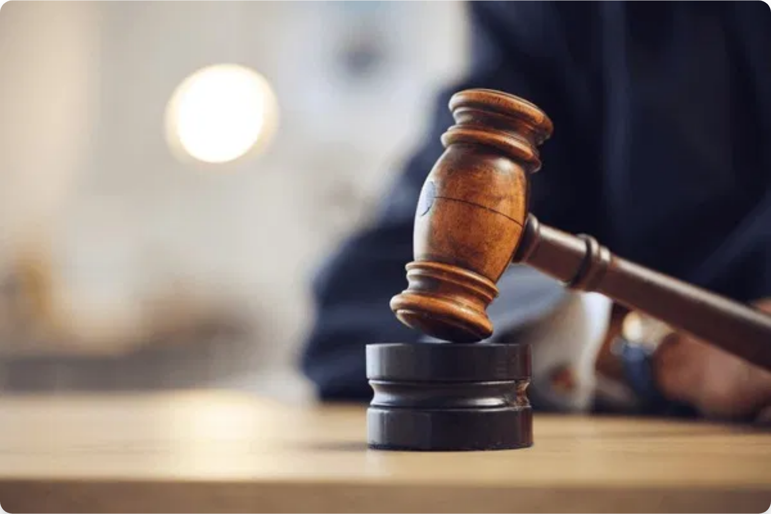
Case Study: hiQ Labs v. LinkedIn
Background:
hiQ Labs, a data analytics company, scraped publicly available
LinkedIn profiles to provide workforce analytics services to businesses
The Dispute:
LinkedIn sent cease-and-desist letter to hiQ
LinkedIn implemented technical measures to block hiQ
hiQ filed lawsuit seeking injunction against LinkedIn
Legal Arguments:
LinkedIn:
Claimed CFAA violation and breach of Terms of Service
hiQ:
Argued data was public and anti-competitive behavior by LinkedIn
Court Decision:
Ninth Circuit ruled in favor of hiQ, finding that the CFAA
does not prohibit accessing publicly available data, even when against
website terms
Significance:
Established important precedent that scraping publicly
available data is not a CFAA violation

Slide 7

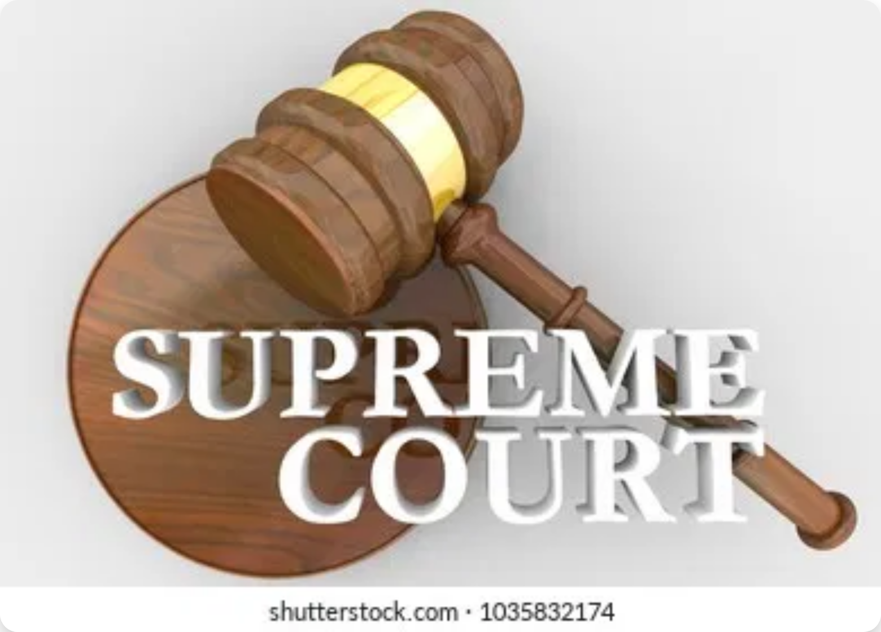

Case Study: Van Buren v. United States (2021)
Background:
Nathan Van Buren, a former police officer, was convicted
under the CFAA for accessing a law enforcement database for improper
purposes, despite having authorization to access the database
Supreme Court Ruling:
In a
6-3 decision
, the Court ruled that the CFAA
does not criminalize the misuse of information one is otherwise authorized
to access
The "Gates-Up-or-Down" Analogy:
If the "gate is up," the individual has authorization to access information regardless of purpose. If the "gate is down," accessing would violate the CFAA.
Impact on Web Scraping:
Narrowed CFAA scope to situations where
someone breaches a technological barrier they're not authorized to pass,
providing stronger legal foundation for scraping publicly available data

Slide 8

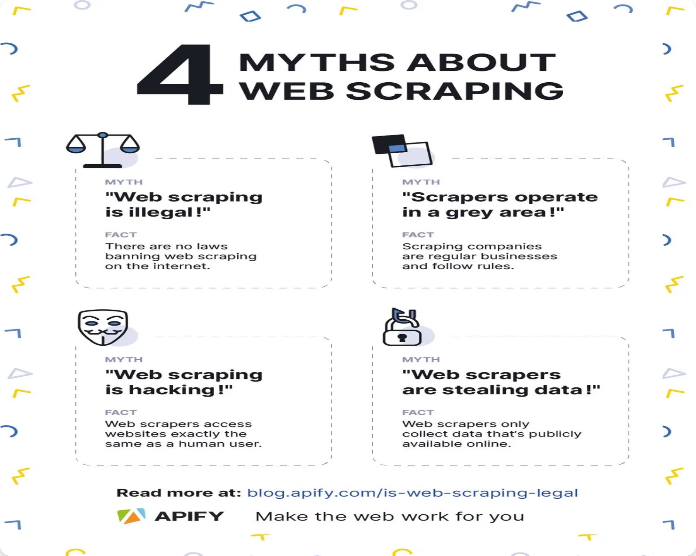
Case Study: Meta v. Bright Data (2024)
Case No. 3:23-cv-00077-EMC (N.D. Cal.)
| January 23, 2024 | Judge Edward Chen
Parties:
Meta Platforms Inc. v. Bright Data Ltd. (company providing
scraping infrastructure and data from publicly available sources)
Legal Arguments:
Meta's Position:
Terms prohibited both logged-on and logged-off scraping
Bright Data's Position:
Terms apply only to data behind password wall
Court Decision:
Ruled in favor of Bright Data, finding "Bright Data did not
'use' Facebook and Instagram when it engaged in public logged-off
scraping"
Significance:
Makes scraping publicly available data on social media
platforms significantly less risky; challenges Meta's ability to prevent
scraping of public data through ToS enforcement

Slide 9
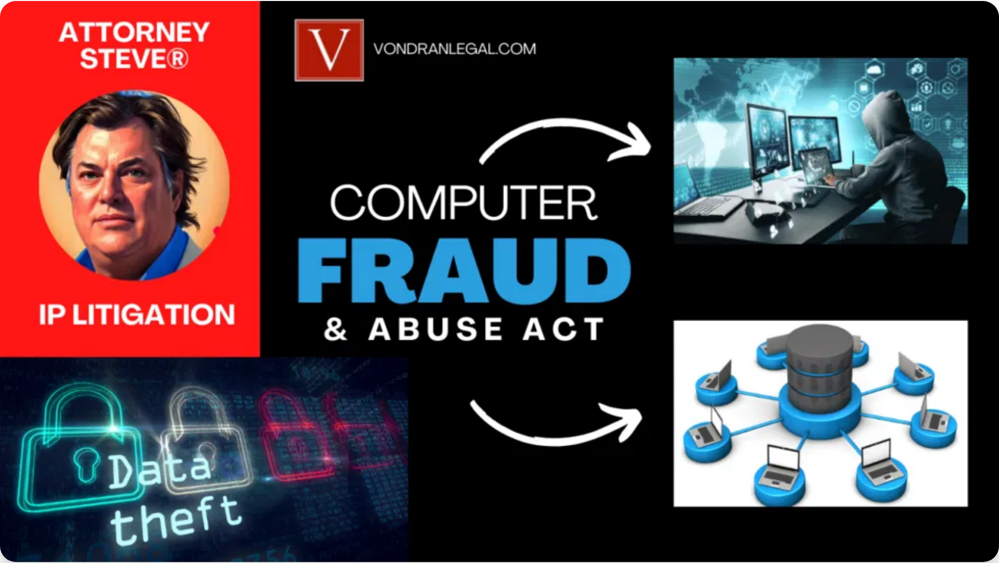
Other Notable Legal Cases
Craigslist v. 3Taps (2012)
• 3Taps scraped Craigslist housing ads despite IP blocks
• Court ruled IP blocks constitute access revocation under CFAA
•
Precedent:
Using proxies to bypass IP blocks may violate CFAA
• Settled for $1 million (donated to Electronic Frontier Foundation)
Ryanair v. PR Aviation (European Court of Justice)
• PR Aviation scraped flight prices from Ryanair's website
• EUCJ ruled owners of public databases can impose access restrictions
•
Precedent:
In EU, Terms of Service restrictions on scraping may be
enforceable
Cambridge Analytica and Facebook (2018)
• Cambridge Analytica obtained data from millions of Facebook users
• Led to investigations, congressional hearings, and legal action
•
Impact:
Increased regulatory oversight of data collection practices

Slide 10


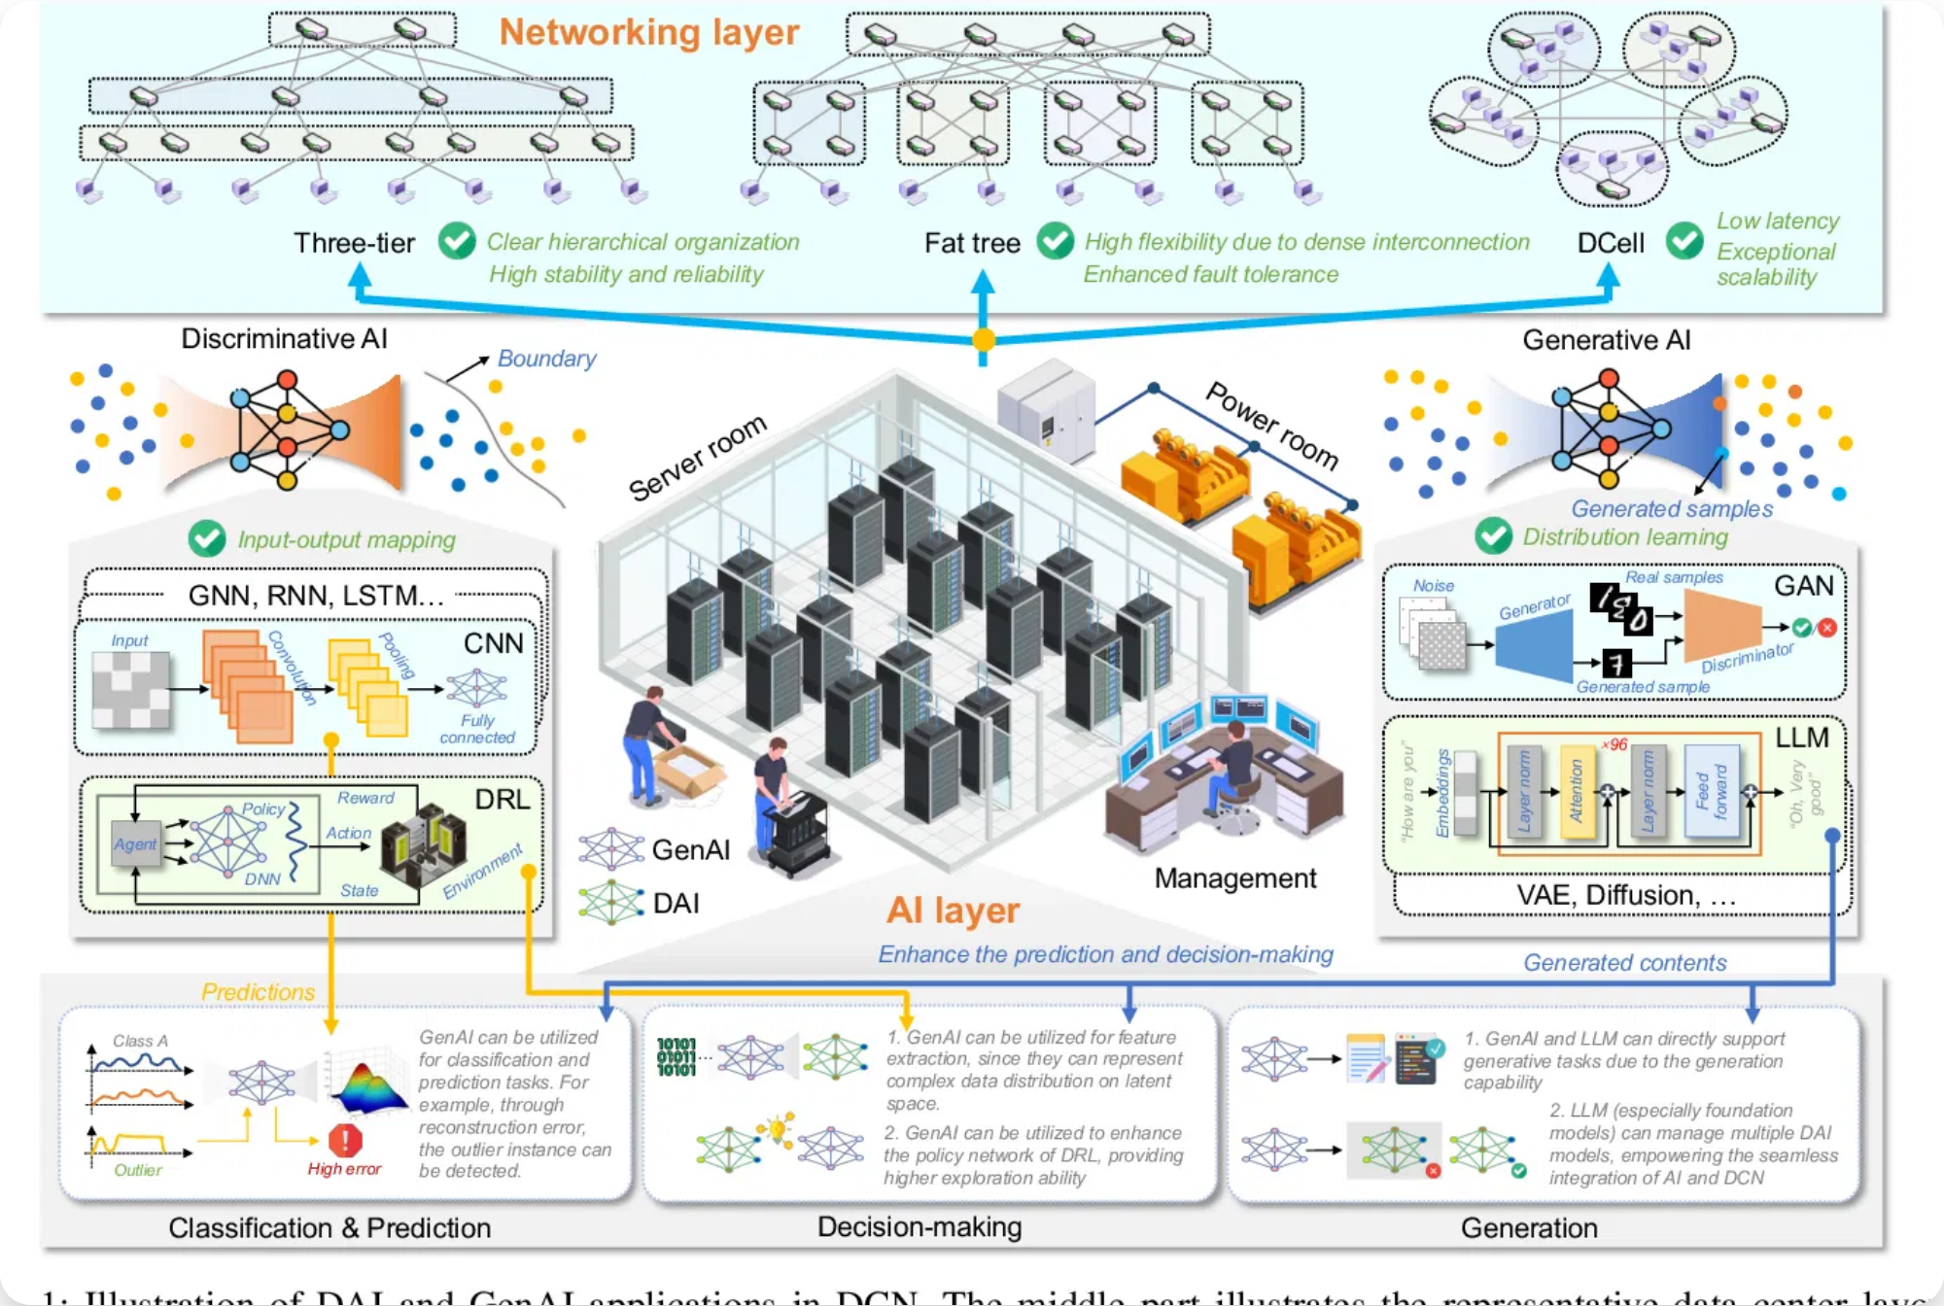

AI Training Data Collection Overview
Scale of Data Collection:
Modern LLMs like ChatGPT, Claude, and Bard
require
trillions of tokens
(word fragments) from hundreds of billions of
webpages, books, and other text sources
Web Scraping Methods:
AI companies deploy sophisticated web crawlers
to systematically extract text from publicly accessible websites, often
without explicit permission
Content Sources:
Training data typically includes:
Public websites (news, blogs, forums, social media)
Books and academic papers
Code repositories
Wikipedia and other encyclopedic sources
Key Concerns:
Lack of transparency about data sources, potential
copyright violations, privacy implications, and limited opt-out mechanisms

Slide 11
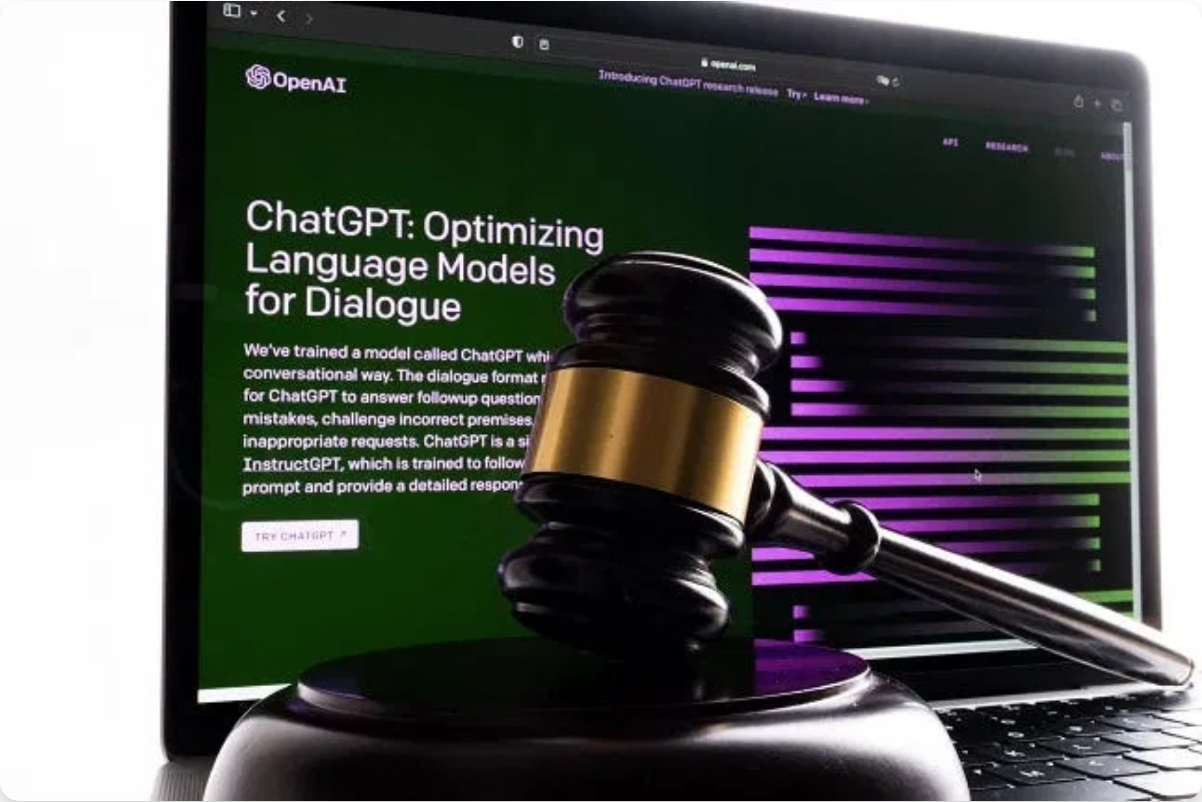
Case Study: The New York Times vs. OpenAI
Filed:
December 27, 2023 |
Status:
Ongoing |
Venue:
Federal Court, New York
The Lawsuit:
NYT sued OpenAI and Microsoft for alleged copyright
infringement, claiming they used millions of NYT articles without
permission to train ChatGPT
Legal Arguments:
NYT's Position:
OpenAI's use doesn't meet "transformative" criteria for fair use
OpenAI's Defense:
Mass scraping is protected under "fair use" doctrine
"There is nothing 'transformative' about using The Times's content without payment to create products that substitute for The Times and steal audiences away from it." - NYT Legal Team
Key Issue:
ChatGPT can reproduce NYT content almost verbatim,
potentially undermining the newspaper's business model
Significance:
Could set precedent for whether using copyrighted material
for AI training constitutes fair use

Slide 12

Case Study: Reddit vs. Anthropic
Filed:
June 4, 2025 |
Status:
Ongoing |
Venue:
California Superior Court, San Francisco
The Lawsuit:
Reddit sued Anthropic (creator of Claude AI) for allegedly
"scraping" comments from millions of Reddit users to train its chatbot
without permission
Legal Arguments:
Reddit's Position:
Breach of terms of service and unfair competition
Anthropic's Response:
"We disagree with Reddit's claims and will defend ourselves vigorously"
"AI companies should not be allowed to scrape information and content from people without clear limitations on how they can use that data." - Ben Lee, Reddit Chief Legal Officer
Legal Distinction:
Unlike other AI lawsuits, this case doesn't allege
copyright infringement but focuses on terms of service violations and unfair
competition
Context:
Reddit has licensing agreements with Google, OpenAI, and
others that pay to train AI systems on Reddit data, which include user
protections and privacy safeguards

Slide 13

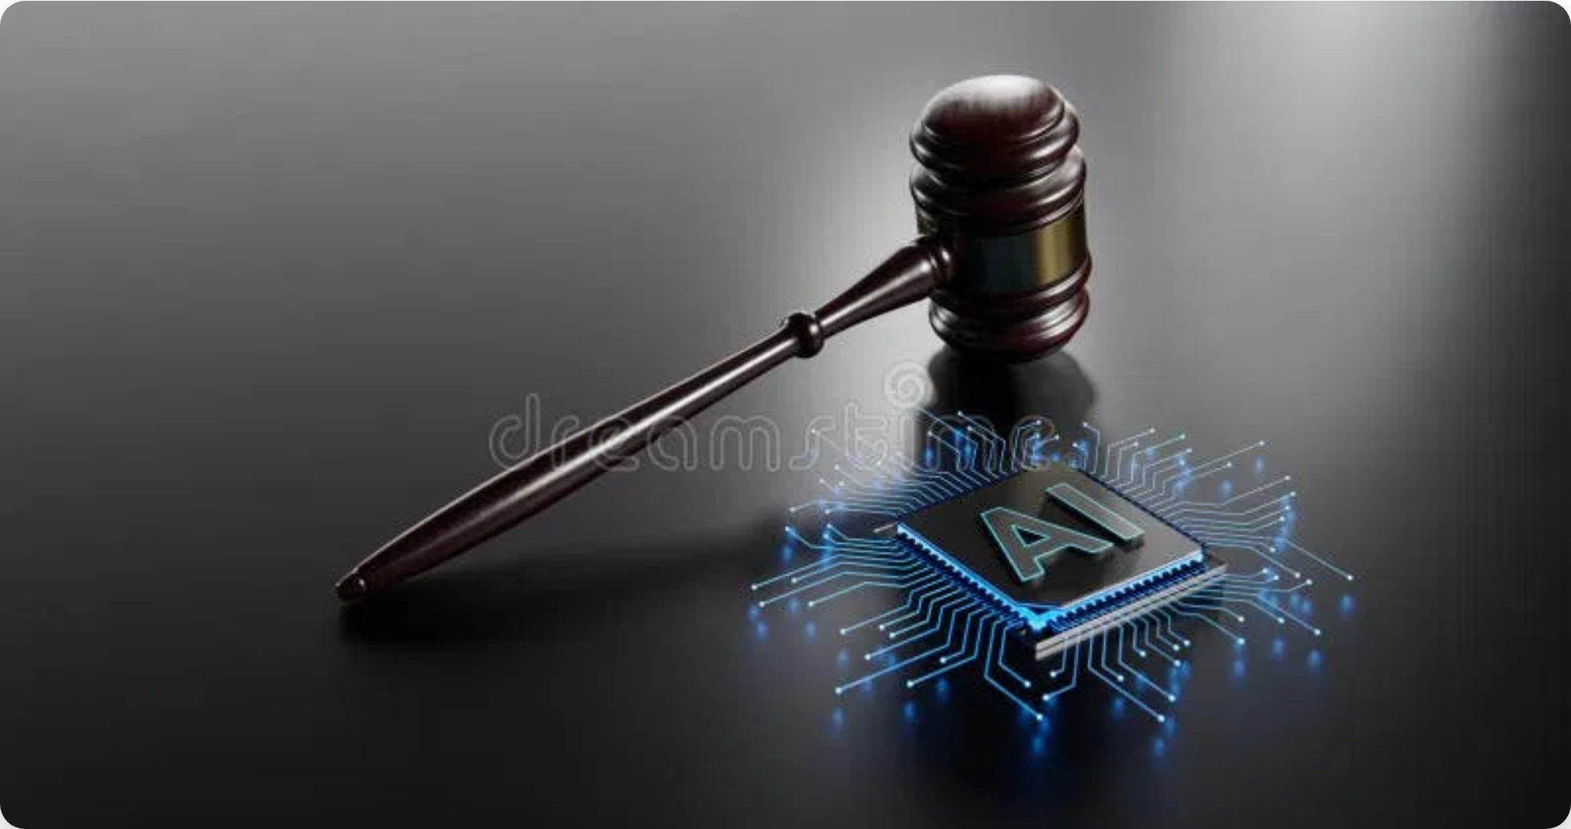
Fair Use Doctrine and AI Training
Fair Use Doctrine:
Legal principle that permits limited use of copyrighted
material without permission for purposes such as criticism, comment,
news reporting, teaching, scholarship, or research
Four Factors of Fair Use:
1. Purpose and Character of Use:
Is it transformative or merely
reproductive?
2. Nature of Copyrighted Work:
Is it creative or factual?
3. Amount Used:
How much of the original work was used?
4. Effect on Market Value:
Does it harm the original work's
market?
Conflicting Court Decisions:
In February 2025, one court ruled AI training
is
not fair use
, while other California decisions found it
can be fair use
with significant caveats
Copyright Office Position:
Using copyrighted works to train AI models
may constitute prima facie infringement, but fair use analysis must be
case-specific

Slide 14

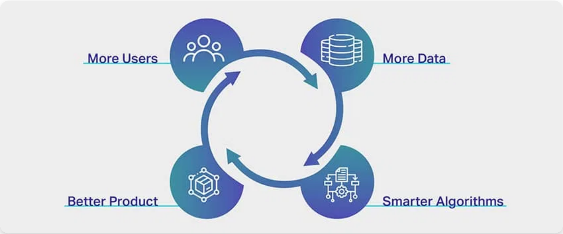

AI Training Data: Best Practices & Future Outlook
Best Practices for AI Companies:
•
Transparency:
Clearly document and disclose training data sources
•
Licensing:
Negotiate fair licensing agreements with content creators
•
Opt-out Mechanisms:
Provide effective ways for websites to exclude
content
•
Attribution:
Acknowledge sources when AI generates derivative
content
Content Creator Protections:
• Use robots.txt to specify scraping permissions
• Implement technical measures to prevent unauthorized scraping
• Consider licensing content through official channels
Regulatory Developments:
EU AI Act places legal obligations on AI
models regarding copyrighted works; U.S. lawmakers debating
compensation frameworks
Future Outlook:
Expect more specific regulations, industry standards for
ethical data collection, and established licensing models for AI training data

Slide 15


Conclusion and Future Outlook
Key Legal Principles:
Recent court decisions have narrowed the CFAA's
scope, establishing that scraping publicly available data is generally
permissible, even when against website terms of service.
Emerging Trends:
Courts are increasingly distinguishing between public
and password-protected data, focusing on technological barriers rather
than contractual terms.
Best Practices for Compliance:
Respect robots.txt directives
Implement reasonable rate limiting
Prioritize data privacy and security
Be transparent about scraping activities
Future Outlook:
As web scraping technology evolves, expect more specific
regulations and guidelines. Companies should stay informed about legal
developments and prioritize ethical data collection practices.

